Slide 1
CSE1004 Network & Communication
Module : HTPPS
Dr. Ganesan R
VIT Chennai

Slide 2



HTTPS

Slide 3
Learning Objectives
HTTPS Connection Initiation
HTTPS Connection Closure

Slide 4
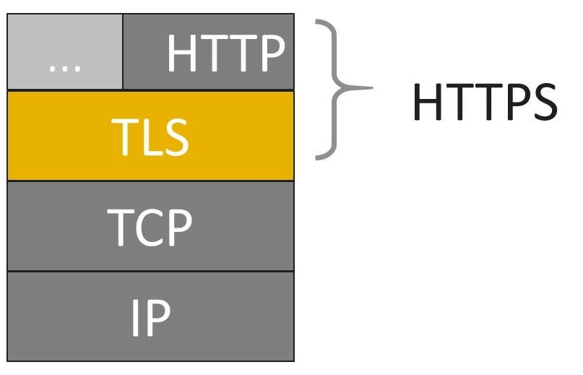
What is HTTPS?
HTTPS (HTTP over SSL) – refers to the combination of HTTP and SSL to implement secure communication between Web browser and Web server
Is built into all modern Web browsers
Principal difference seen by a user is that URL addresses begin with https:// rather than http://
Normal http:// uses port 80 whereas https:// uses port 443, which invokes SSL

Slide 5
…What is HTTPS?
When HTTPS are used, the following elements of the communication are encrypted:
URL of the requested document
Contents of the document
Contents of the browser forms (filled in by browser user)
Cookies sent from browser to server and from server to browser
Content of HTTP header

Slide 6
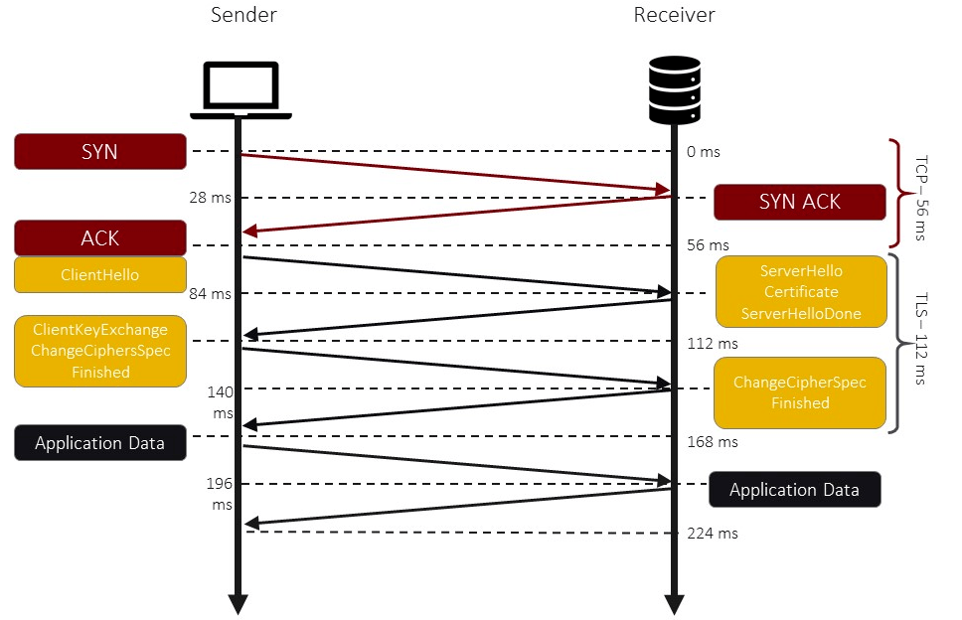
HTTPS Connection Initiation

Slide 7
HTTPS Connection Closure
HTTP Client or Server can indicate the closing of a connection by including a line in an HTTP Record :“Connection: Close”
Closure of a connection involves closing underlying TCP connection
Proper way to close connection – Each side should use TLS alert protocol to send a message “close_notify” alert

Slide 8
Additional Learning Resources
TCP/IP Protocol Suite, Behrouz A. Forouzan, McGraw Hill, 4th Edition
Cryptography and Network Security, William Stallings, Prentice Hall, 5th Edition
HTTPS online resource: https://en.wikipedia.org/wiki/HTTPS
https://www.tutorialsteacher.com/https/what-is-https

Slide 9
Practice Quiz : Self-Check
Click below link for the self-check (2 Questions)
https://forms.gle/GQGec7RcgY9e9KccA

